Slide 1
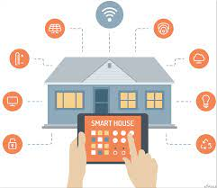
Project Report
Saptajit Banerjee
20BCE1513

Slide 2
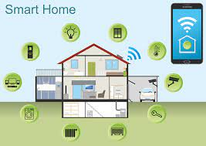
Title
Remote Home Monitoring & Control

Slide 3
Abstract
People nowadays are very busy with their work for which they pay less attention to their household work. It becomes hectic for people to manage their office and their household work. To make household work easier and reduce the burden on people, I have proposed a system that can automate some parts of the household work and also secure the house in case of an intruder breaks in.​
The proposed system will enable the user to control the devices in the system remotely by using a mobile app. The app will communicate with the system using the HTTP protocol. For the app to communicate with the system, both the mobile and the system have to be connected with the same WLAN.
A PIR (Passive Infrared) sensor too will be installed in the system for security purposes. The PIR sensor will notify the system if it detects an intruder and the system, in turn, will send notifications to the user in the app as well as the user’s Gmail account​

Slide 4
Introduction
The project consists of a Raspberry Pi 4 Model B, a circuit with different LEDs which is made on top of breadboard and a smart phone app. The Raspberry Pi will control the circuit using the GPIO pins. A HTTP Server will be set up on the Raspberry Pi to serve HTTP requests which will be wirelessly transmitted by the smart phone. The circuit consists of 4 LEDs and 1 PIR sensor
The smart phone app will have many buttons to transmit / send multiple requests to the HTTP server. Each button generates different HTTP requests and each request will tell the HTTP server to perform different sets of actions. When the button is pressed the app will tell what action the Raspberry Pi will perform which will be the result of the HTTP request that was generated and transmitted to the Raspberry Pi
The ON button under Enable Security activates the PIR sensor in the system. If the PIR sensor senses any motion , it will send the signal to the Raspberry Pi. The Raspberry Pi in turn will turn ON the 4th LED and an email will be sent to alert the user of the intrusion. The email will contain the time and the date of the intrusion. The OFF button will disable the 4th LED.

Slide 5
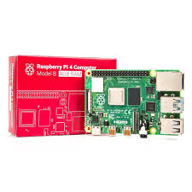
Hardware and Software Requirements
Hardware Requirements
Raspberry Pi 4 Model B 2GB RAM
Smart Phone
PIR Sensor
LEDs
Bread Board
Jumper Wires
Micro SD Card
Multi Format Card Reader
Ethernet Cable

Slide 6

Software Requirements:
PuTTy
Raspberry Pi Imager
VNC Viewer
Kodular App Inventor
Android OS
Raspbian OS
Python

Slide 7
Literature Survey
A zigbee-based home automation system
With the rapid expansion of the Internet, there is the added potential for the remote control and monitoring of network enabled devices. However, the adoption of home automation systems has been slow. This paper identifies the reasons for this slow adoption and evaluates the potential of ZigBee for addressing these problems through the design and implementation of a flexible home automation architecture. A ZigBee based home automation system and Wi-Fi network are integrated through a common home gateway. The home gateway provides network interoperability, a simple and flexible user interface, and remote access to the system.
Reference: https://ieeexplore.ieee.org/abstract/document/5174403

Slide 8
Home automation in the wild: challenges and opportunities
Home automation technologies have not been widely adopted despite being available for over three decades. To gain insight into this state of affairs, home visits were conducted in 14 households with home automation. The long term experience, both positive and negative, of the households interviewed illustrates four barriers that need to be addressed before home automation becomes amenable to broader adoption. These barriers are high cost of ownership, inflexibility, poor manageability, and difficulty achieving security. The findings also provide several directions for further research, which include eliminating the need for structural changes for installing home automation, providing users with simple security primitives that they can confidently configure, and enabling composition of home devices.
Reference: https://dl.acm.org/doi/abs/10.1145/1978942.1979249

Slide 9
Java-based home automation system
This paper presents the design and implementation of a Java-based automation system that can monitor and control home appliances via the World Wide Web. The design is based on a stand alone embedded system board integrated into a PC-based server at home. The home appliances are connected to the input/output ports of the embedded system board and their status are passed to the server. The monitoring and control software engine is based on the combination of JavaServer pages, JavaBeans, and interactive C. The home appliances can be monitored and controlled locally via the embedded system board, or remotely through a Web browser from anywhere in the world provided that an Internet access is available. The system is scalable and allows multi-vendor appliances to be added with no major changes to its core.
Reference: https://ieeexplore.ieee.org/abstract/document/1309414

Slide 10
An Integral and Networked Home Automation Solution for Indoor Ambient Intelligence
The system presented in this article considers user requirements, including novel advances, all in an integral home automation solution suitable for many services. The architecture's modular nature allows direct adaptation to specific cases using standard domotic technologies, for managing in-house devices, and a proposal of an IP-based network for connecting the main home automation module with other platform elements. A remote security system has been developed, and managing tasks are enabled via in-home control panels and an advanced 3D application for local and remote homeowner access. The system has been deployed on a prototype house, testing a wide set of domotic services.
Reference: https://ieeexplore.ieee.org/abstract/document/5396313

Slide 11
Wireless Controlled Methods via Voice and Internet (e-mail) for Home Automation System
This paper presents a wireless Home Automation System (HAS) that mainly performed by computer. The system is designed with several control methods in order to control the target electrical appliances. The computer application is designed in Microsoft Windows OS that integrated with speech recognition voice control by using Microsoft Speech Application Programming Interface (SAPI). The voice control method provides more convenience especially to the blind and paralyzed users at home. The system is designed to perform short distance control by using wireless Bluetooth technology and long distance control by using Simple Mail Transfer Protocol (SMTP) email control method.
Reference: https://citeseerx.ist.psu.edu/viewdoc/download?doi=10.1.1.411.911&rep=rep1&type=pdf

Slide 12
Bluetooth based home automation system
This paper describes an application of Bluetooth technology in home automation and networking environment. It proposes a network, which contains a remote, mobile host controller and several client modules (home appliances). The client modules communicate with the host controller through Bluetooth devices. The objective of this proposal was to develop a home automation system based on Bluetooth wireless technology. The result is the HAP, which allows the user to monitor and control different appliances connected over a Bluetooth network in home environment. The system has been demonstrated to be functioning by developing a room temperature control system.
Reference: https://www.sciencedirect.com/science/article/abs/pii/S014193310200039X

Slide 13
Smart Home automation system using IR, bluetooth, GSM and android
In this paper a home automation system that uses IR remote, Bluetooth and GSM to control AC appliances using android app is introduced that is easy to use over the traditional method of the switch. Therefore, the motivation behind the development of this system is to let people know about these technologies, and make the system as simple as possible for an ordinary person to understand. The result of this research is the implementation of home automation system which involves control and automation of home appliances through mobile application from remote locations.
Reference: https://ieeexplore.ieee.org/abstract/document/8313770

Slide 14
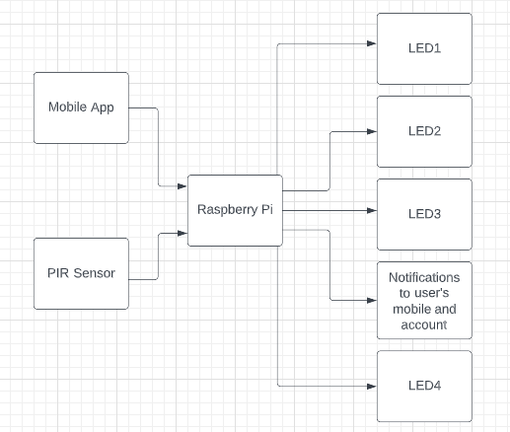
Block Diagram

Slide 15
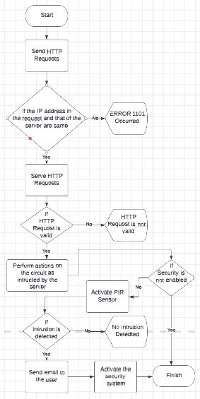
Flow Diagram

Slide 16
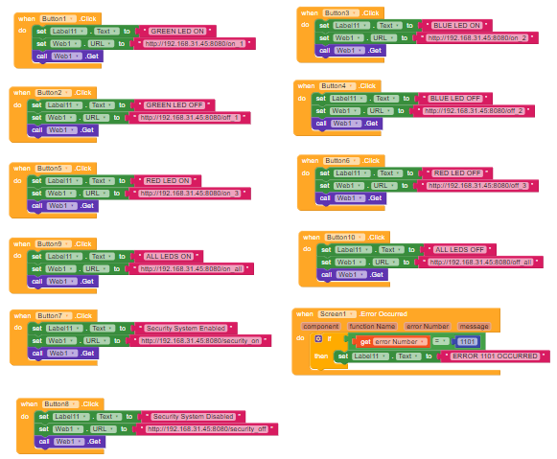
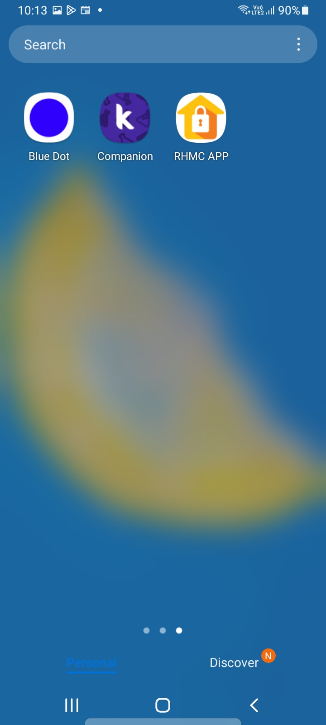
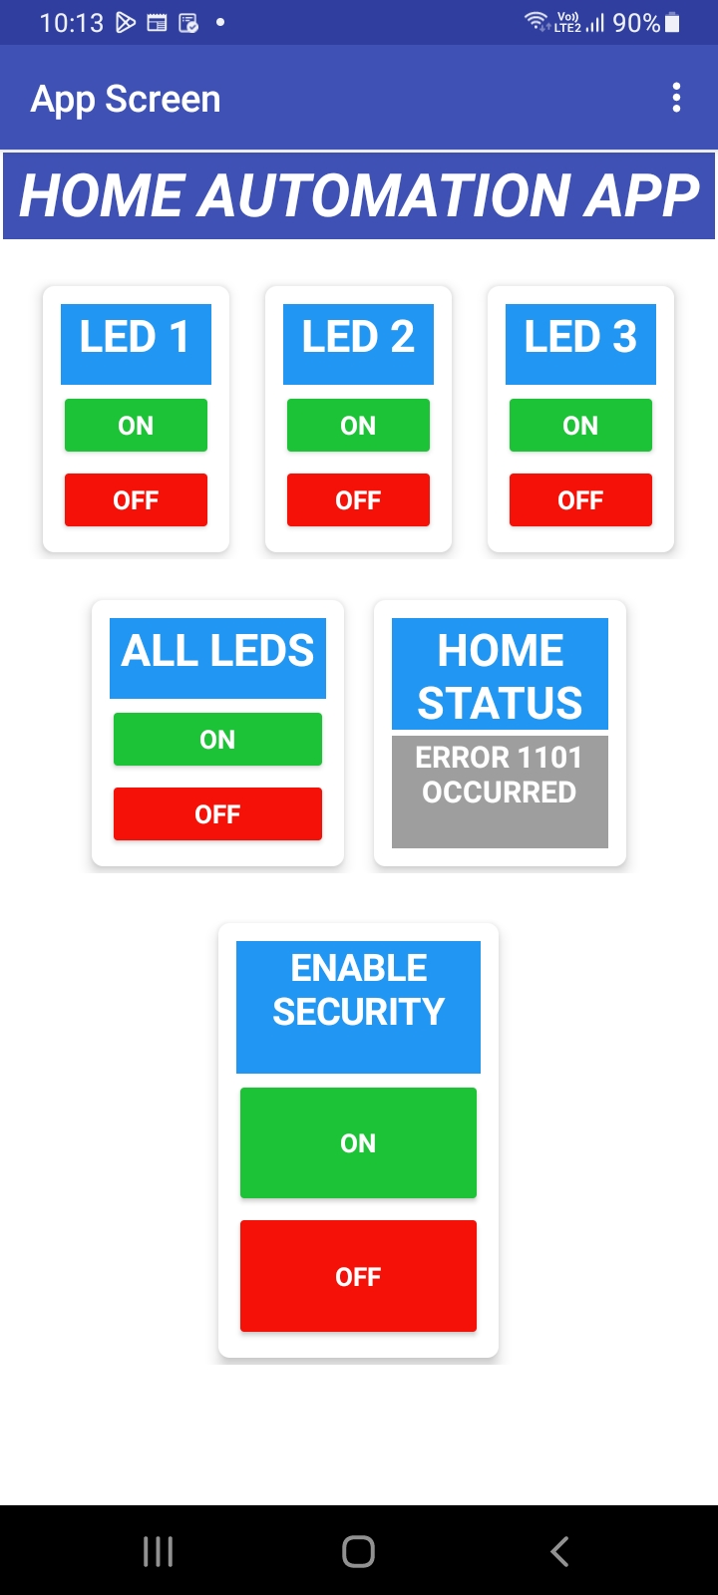
Components Connection
Home Automation App

Slide 17
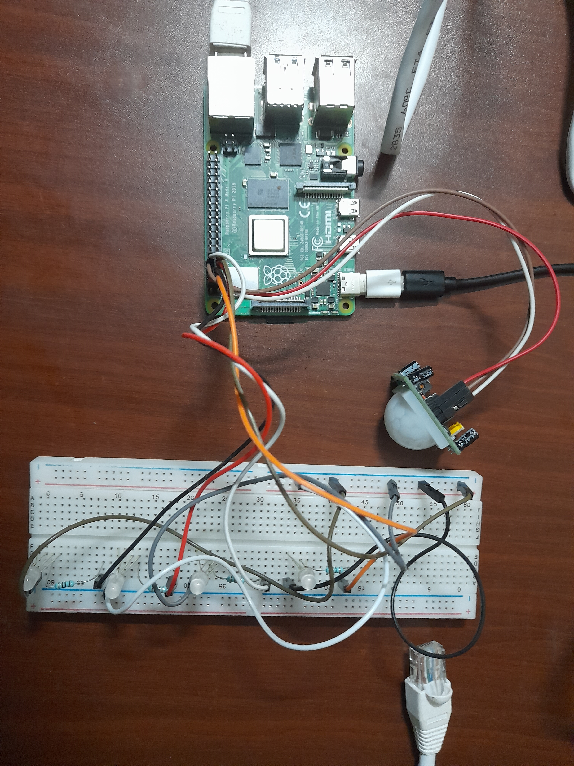
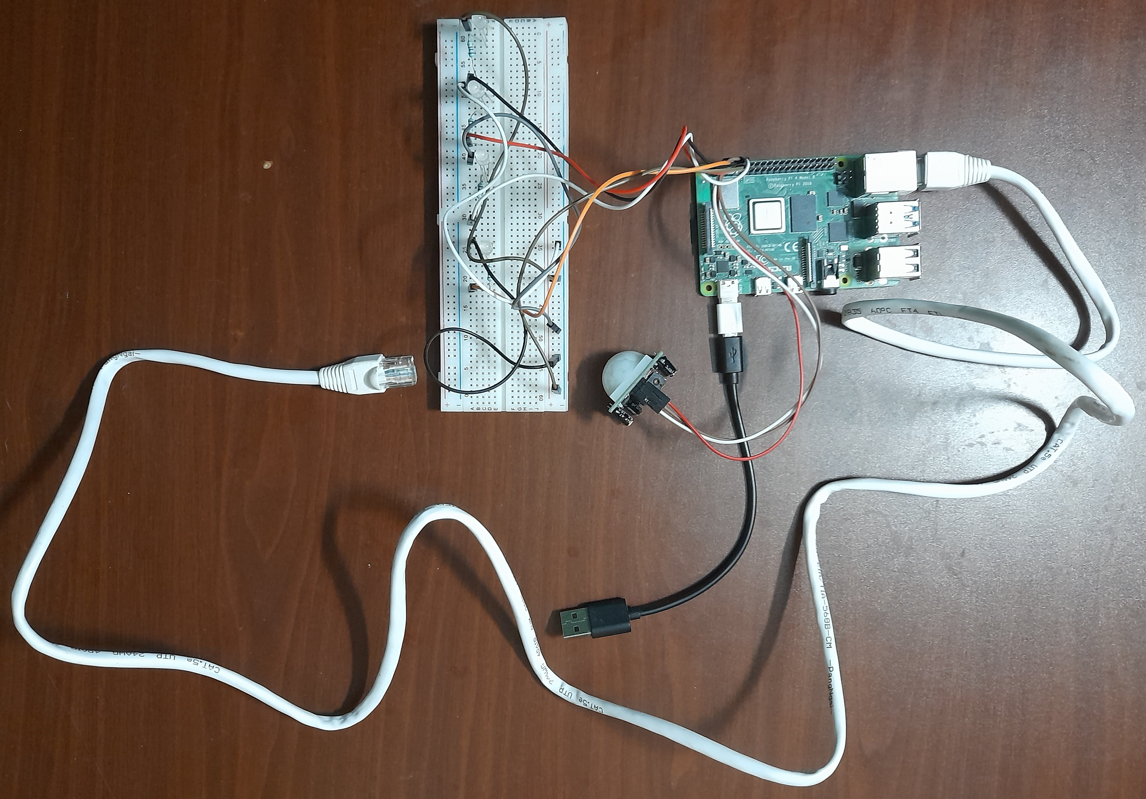
Home Automation System

Slide 18
Results and Discussion
The user can control and communicate with the system remotely and wirelessly through the mobile App
The mobile app enables the user to remotely and wirelessly switch on or switch off any device in the circuit
The user can remotely monitor the status of the system by seeing the emails sent to the user’s Gmail account. These emails are sent by the Raspberry Pi

Slide 19
Conclusion
The HTTP protocol can be efficiently used for IoT applications such as Home Automation. To implement the HTTP protocol, the controller service of an IoT system must have an active HTTP Server which successfully serves the HTTP Requests which are received by the device which houses that controller service
The things in the IoT system as well as users’ devices should have the capability to send HTTP Requests to the controller device in order to communicate the IoT system and each HTTP Request sent must have the IPv4 address of the controller device
The IoT system can use the SMTP protocol to send messages to the users to notify them of the status of the system
Incase WiFi connection is not available, the things and users can still commnicate or control the devices in the IoT system by connecting the users’ smart phones to the controller device of the IoT system through Mobile Hotspot or Bluetooth

Slide 20
References
https://ieeexplore.ieee.org/abstract/document/5174403
https://dl.acm.org/doi/abs/10.1145/1978942.1979249
https://ieeexplore.ieee.org/abstract/document/1309414
https://ieeexplore.ieee.org/abstract/document/1309414
https://citeseerx.ist.psu.edu/viewdoc/download?doi=10.1.1.411.911&rep=rep1&type=pdf
https://www.sciencedirect.com/science/article/abs/pii/S014193310200039X
https://ieeexplore.ieee.org/abstract/document/8313770

